Slide 1
CLINIC WAIT TIME ANALYSIS
Presented by: Jan “Jett” Barlaan

Slide 2
CONTENTS
01 Problem & Objective
02 Insights Development
03 Analysis
04 Conclusion

Slide 3
What are we talking about?

Slide 4
What are we talking about?
Problem Statement: This clinic has received several complaints regarding wait times

Slide 5
01
Problem & Objective
Objective: Identify what is contributing to long wait times
Questions from Management
Are staffing issues present?
Do these complaints have a legitimate basis?
Is the clinic too busy?
Is it caused by certain patient types/classes?

Slide 6
02 Insights Development
How do we develop insights? (W.H.W)
What are the business goals?
Decreasing long wait times
What are the trends?
What times of the day have an increased patient load?
What days of the week have increased wait times?
How can we fix the trends if there are any?
Appropriate Staffing
Why are we implementing changes, if any?
Increase efficiency
Improve quality of service

Slide 7
03 Analysis
Insurance Type
Analysis shows that there is no significant difference in wait times
Medicare patients have the longest wait time, but may be an outlier
Needs more data and larger sample size to be conclusive

Slide 8
03 Analysis
Days of the Week
Mondays and Wednesdays have the longest wait times
Monday 49 min
Wednesday 47 Min
The average wait time is 44 minutes

Slide 9
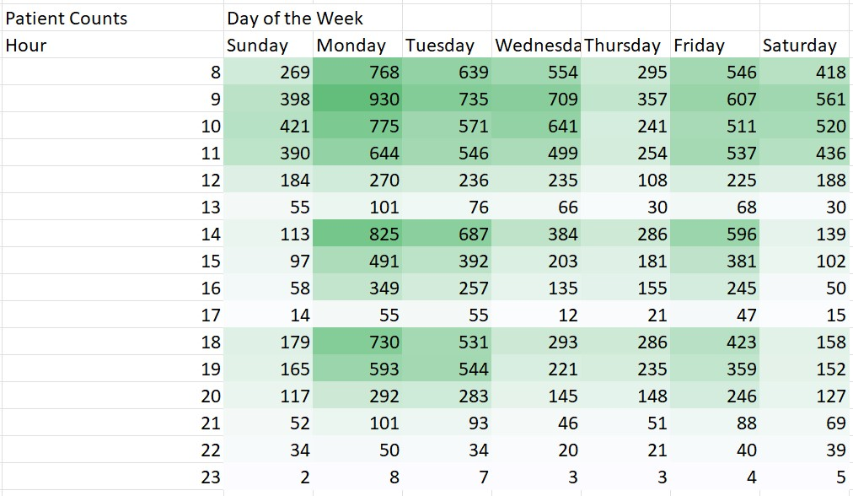
03 Analysis
Days of the Week (Patient Counts)
A heat map also shows higher patient numbers in the morning

Slide 10
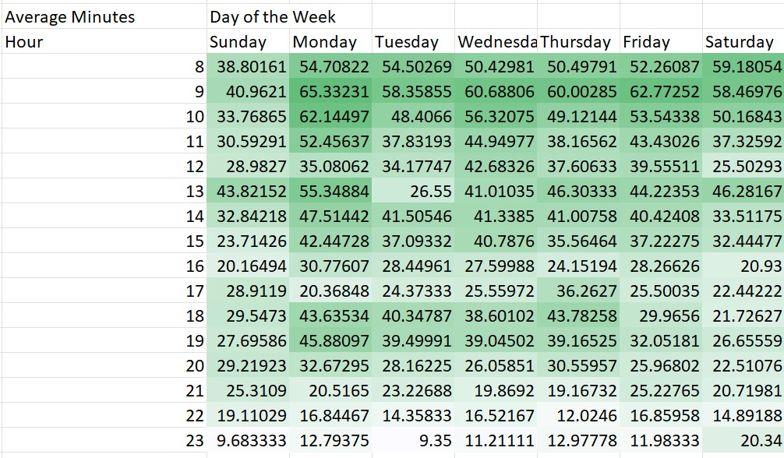
03 Analysis
Days of the Week (Average Wait Times)
More heat maps
In addition to mornings, certain instances in the afternoon and evening also have higher average wait times

Slide 11
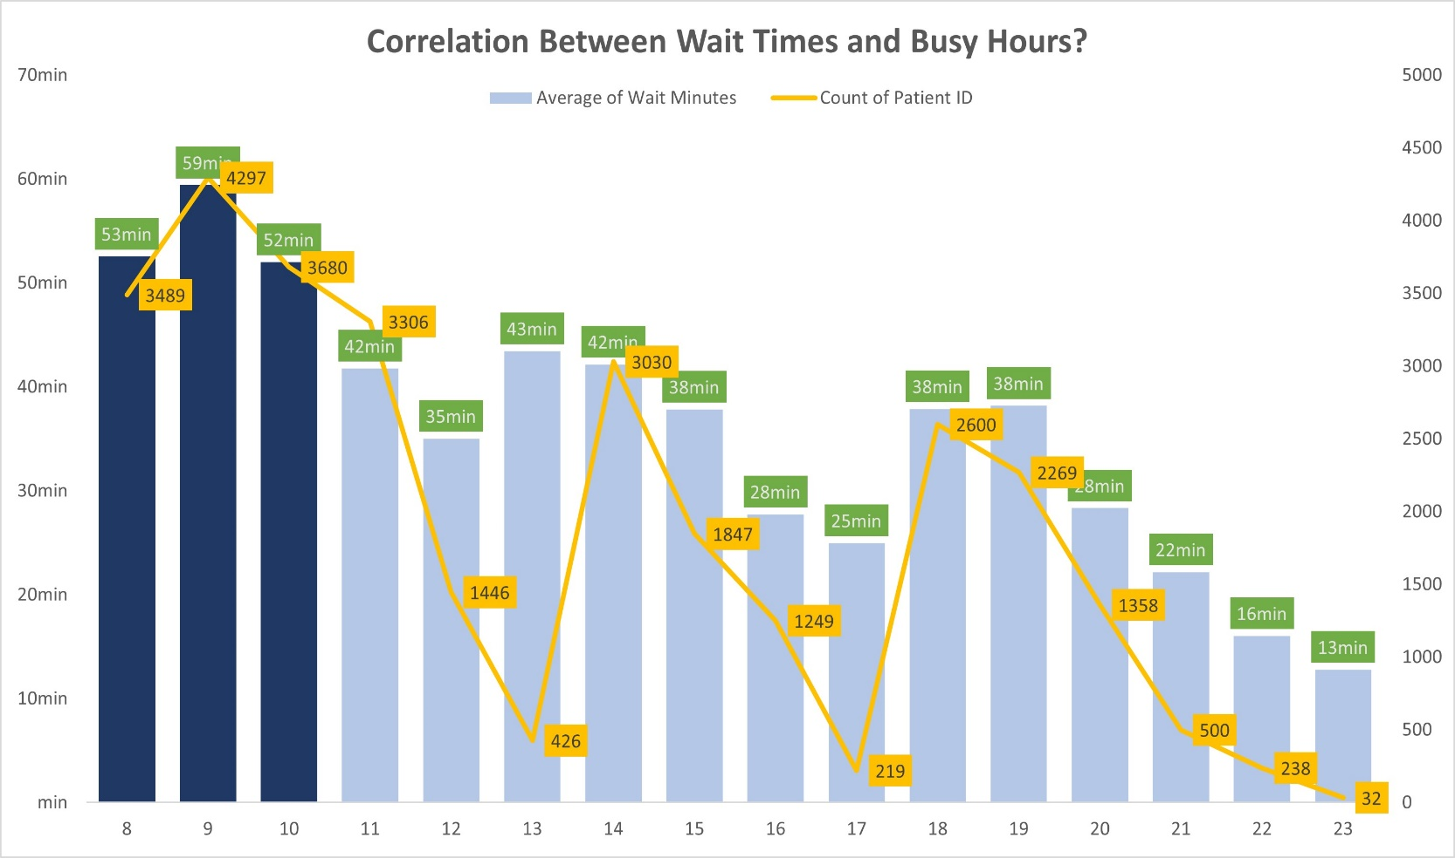
03 Analysis
Staffing
Data shows that overall staffing is adequate
However, between the hours of 8 – 10 AM, extra staff may be needed

Slide 12
03 Analysis
Staffing Cont.
What type of extra staff is needed?
Medical staff such as extra RNs should be given more support since we’re assuming that the wait time accrued before seeing a physician is limited by the number of physicians

Slide 13
04 Conclusion
Summary
Based on the analyses and findings, adding extra support and bolstering the morning staff such as RNs, tech, etc. may help alleviate the longer wait times.
Additional Insights and Thinking Beyond
A limitation to this dataset is there is no metric signifying the specific time which the patient has seen the physician.
An analysis of the financial cost of adding extra staff in the morning rush periods vs potential losses in continuing unchanged may also be beneficial.
The dataset used to conduct these analyses is limited by the fact that all data is constrained to the month of November 2019 for this particular clinic.
Obtaining a dataset containing all 12 months of the year for this location would provide a more complete story
In addition, tracking yearly trends between other clinics with similar problems can provide more relative insights
Caveats to consider include other issues that may not be related to staffing, such as competency amongst varying staff members
Different clinics may have slightly varying logistics processes. We should not assume that using wait times alone is a one size fits all method of recording metrics of efficiency

Slide 14
THANK YOU

